Slide 1

Accounting

Slide 2
Configuration
Chart of Account
JV
Payment
Recu - 1
Recu - 2

Slide 3
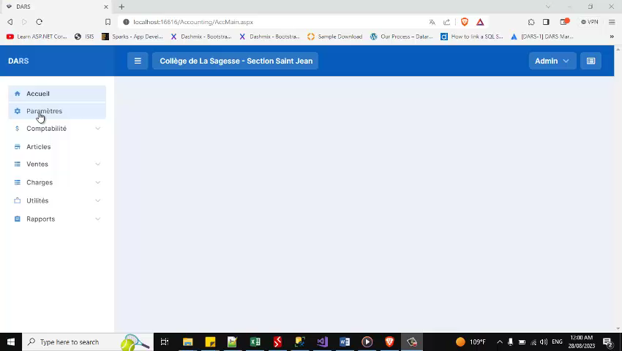
1- Configuration

Slide 4
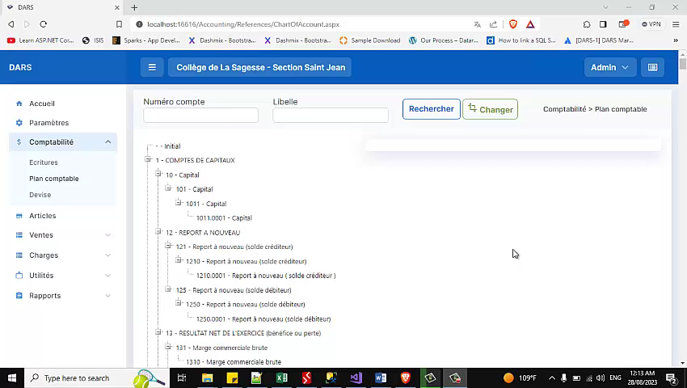
Chart of Account

Slide 5

JV

Slide 6
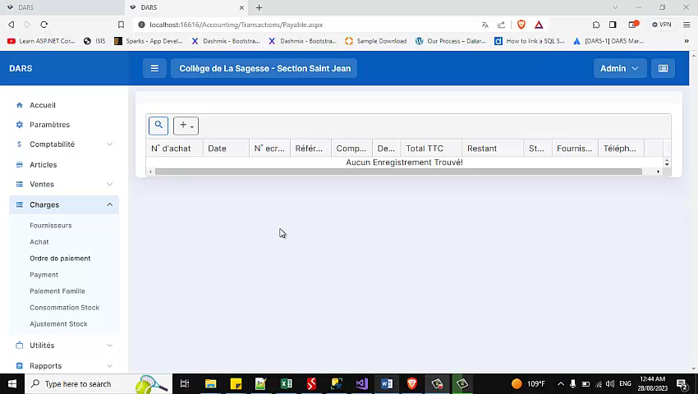
Payment

Slide 7
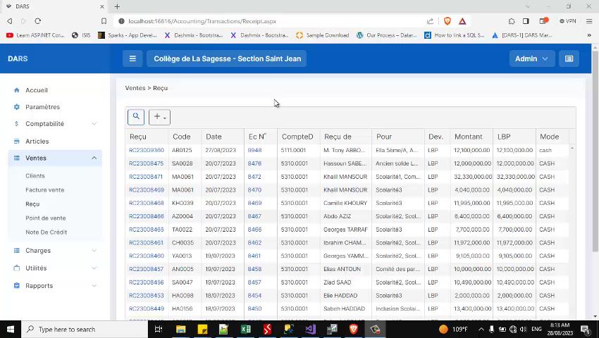
Recu-1

Slide 8
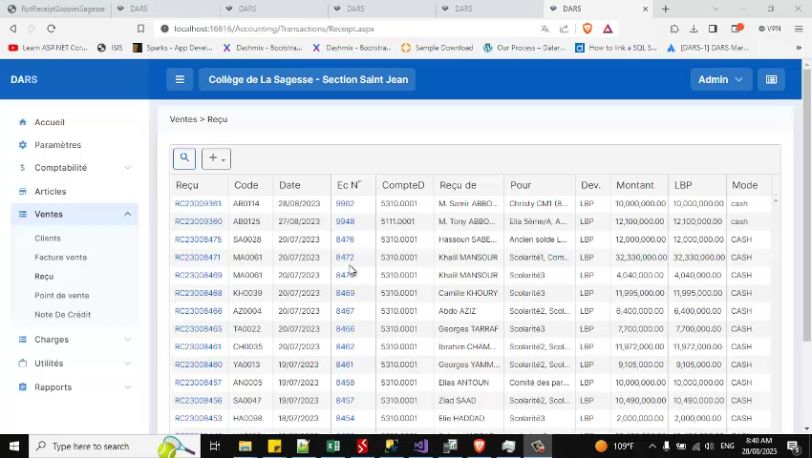
Recu -2

Slide 9
Merci

