Slide 1

Transportation

Slide 2
Transportation

Slide 3
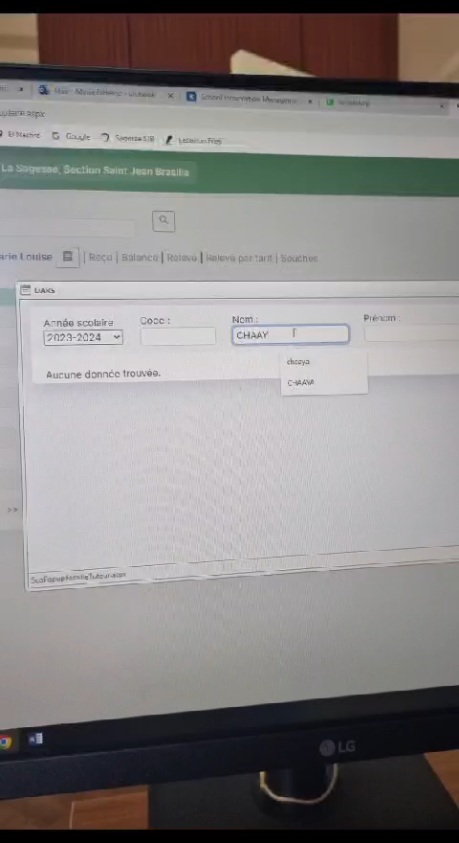
1- Transportation

Slide 4
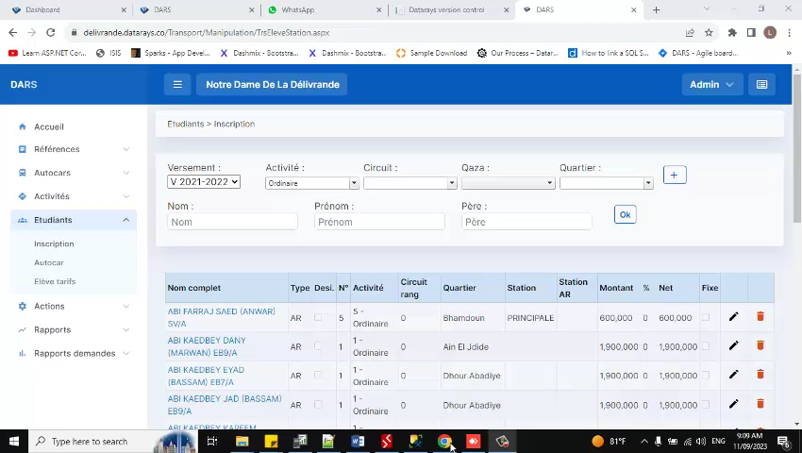
Transportation – part 1
Transportation

Slide 5
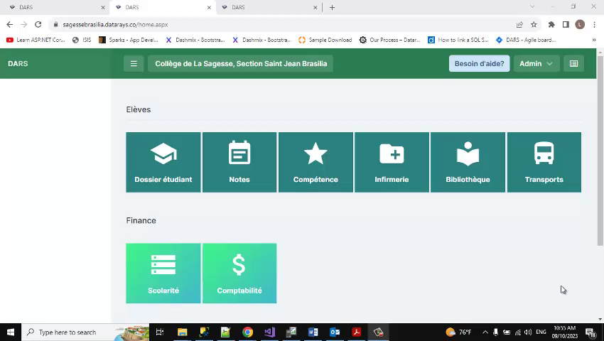
Transportation - Part2

Slide 6
Merci

